Slide 1
CS101 Algorithms and Data Structures
Minimum Spanning Tree
Textbook Ch 23
Notes:
Adapted from the slides by Douglas Wilhelm Harder of U Waterloo (https://ece.uwaterloo.ca/~dwharder/aads/Lecture_materials/)
May also contain material from the slides at https://courses.cs.washington.edu/courses/cse326/03wi/326lecturesb.shtml (by Dan Suciu of U Washington)

Slide 2
Outline
In this topic, we will
Define a spanning tree
Define the weight of a spanning tree in a weighted graph
Define a minimum spanning tree
Consider applications
List possible algorithms

Slide 3
Outline
Definition and applications
Prim’s algorithm
Kruskal’s algorithm

Slide 4
Spanning trees
Given a connected graph with n vertices, a spanning tree is defined as a subgraph that is a tree and includes all the n vertices
It has n − 1 edges
A spanning tree is not necessarily unique

Slide 5
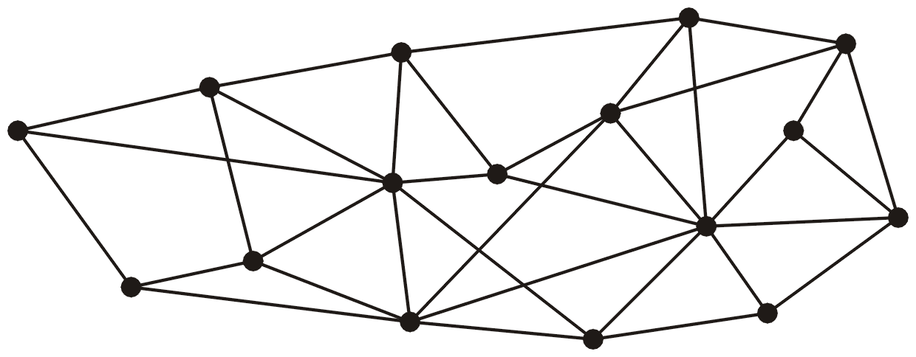
Spanning trees
This graph has 16 vertices and 35 edges

Slide 6
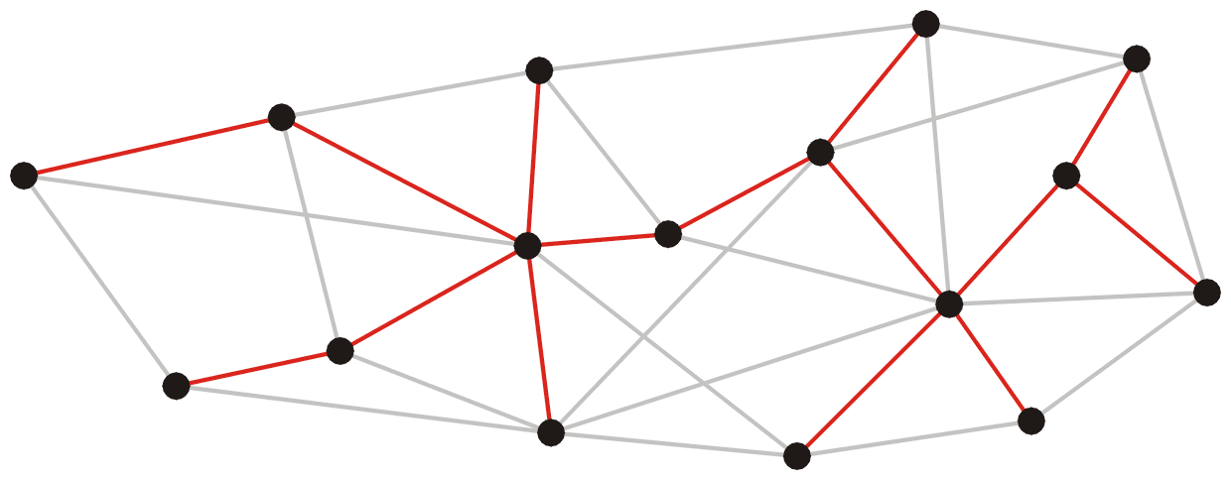
Spanning trees
These 15 edges form a spanning tree

Slide 7
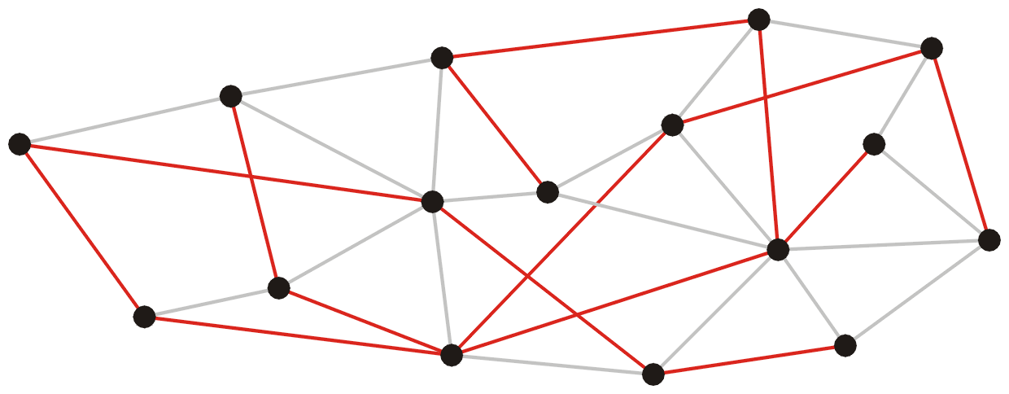
Spanning trees
As do these 15 edges:

Slide 8
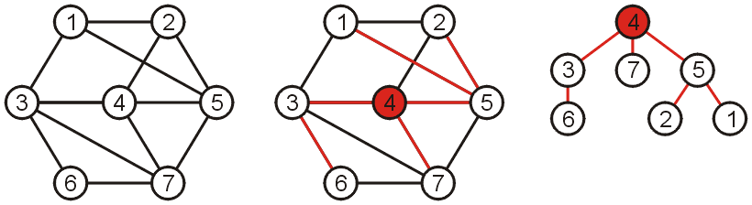
Spanning trees
Notes:
Such a collection of edges is called a tree because if any vertex is taken to be the root, we form a tree by treating the adjacent vertices as children, and so on...

Slide 9
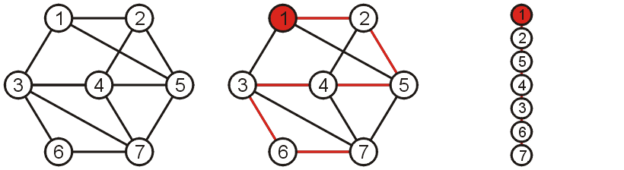
Spanning trees
Notes:
Nor do they necessarily have nice properties

Slide 10

Spanning trees on weighted graphs
The weight of a spanning tree is the sum of the weights on all the edges which comprise the spanning tree
The weight of this spanning tree is 20

Slide 11
Spanning trees on weighted graphs
The weight of a spanning tree is the sum of the weights on all the edges which comprise the spanning tree
11
8
13
4
7
9
2
1
5
Notes:
Now, let’s get a quick definition before we move on to Kruskal’s algorithm.
Which of these three is the minimum spanning tree? (The one in the middle)

Slide 12
Minimum Spanning Trees
Which spanning tree minimizes the weight?
Such a tree is termed a minimum spanning tree
11
8
13
4
7
9
2
1
5

Slide 13
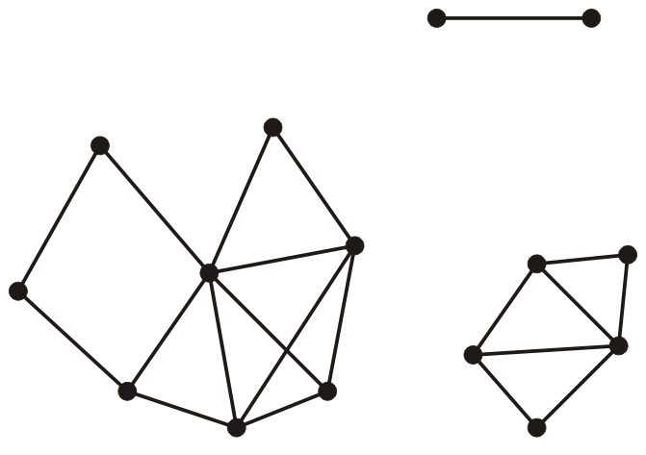
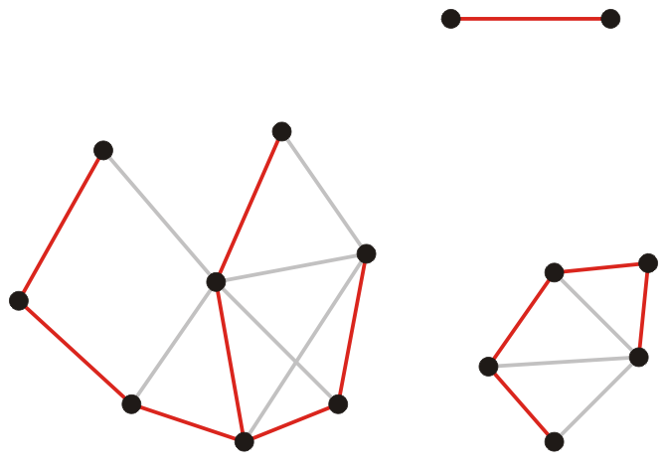
Spanning forests
Suppose that a graph is composed of N connected vertex-induced sub-graphs
In this case, we may define a spanning forest as a collection of N spanning trees, one for each connected vertex-induced sub-graph
A minimum spanning forest is therefore a collection of N minimum spanning trees, one for each connected vertex-induced sub-graph

Slide 14
Unweighted graphs
Observation
In an unweighted graph, we nominally give each edge a weight of 1
Consequently, all minimum spanning trees have weight |V| – 1

Slide 15
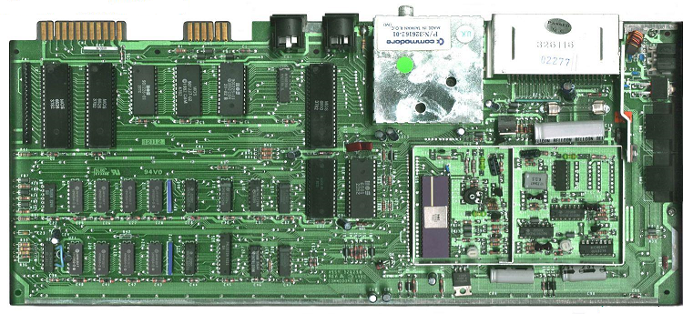

Application
Consider supplying power to
All circuit elements on a board
A number of loads within a building
A minimum spanning tree will give the lowest-cost solution
www.kpmb.com
www.commedore.ca

Slide 16
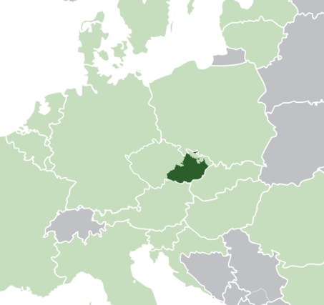
Application
The first application of a minimum spanning tree algorithm was by the Czech mathematician Otakar Borůvka who designed electricity grid in Moravia in 1926
Notes:
www.kpmb.com
www.commedore.ca

Slide 17
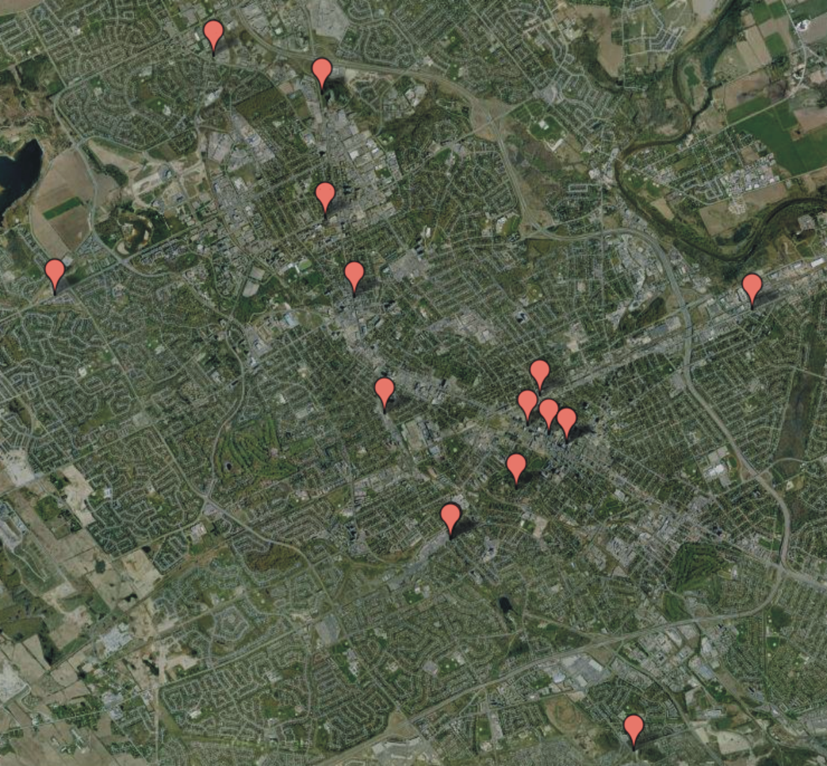
Application
Consider attempting to find the best means of connecting a number of houses
Minimize the length of transmission lines

Slide 18
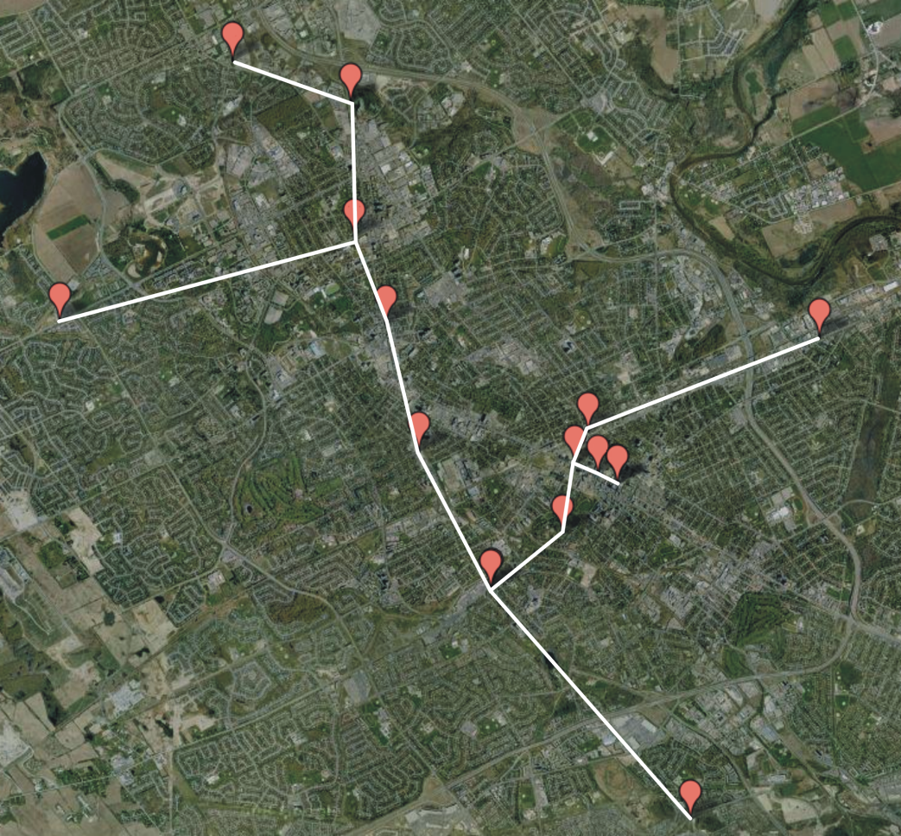
Application
A minimum spanning tree will provide the optimal solution

Slide 19
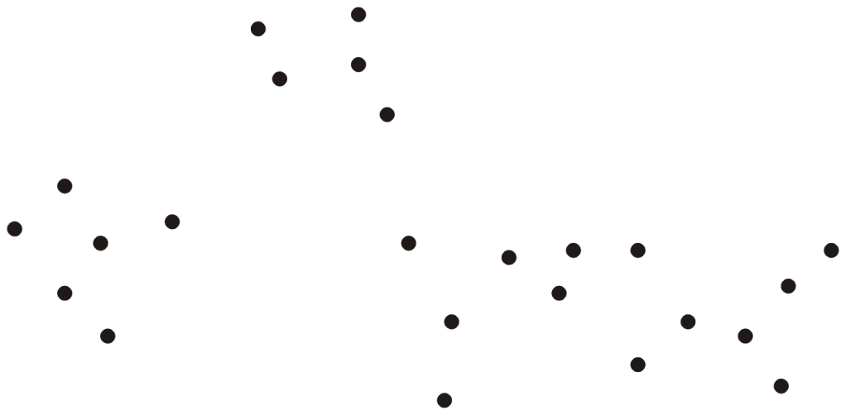
Application
Consider an ad hoc wireless network
Any two terminals can connect with any others
Problem:
Errors in transmission increase with transmission length
Can we find clusters of terminals which can communicate safely?

Slide 20
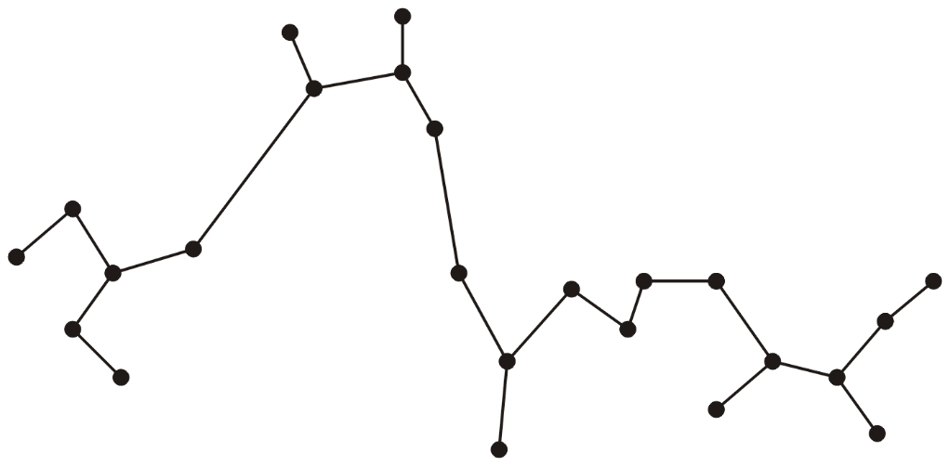
Application
Find a minimum spanning tree

Slide 21
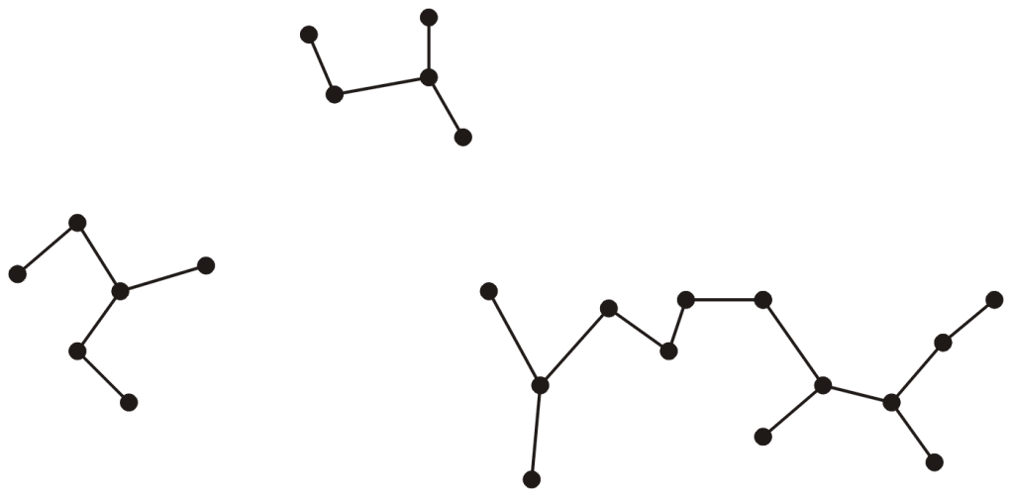
Application
Remove connections which are too long
This clusters terminals into smaller and more manageable sub-networks

Slide 22
Minimum Spanning Trees
Simplifying assumption:
All edge weights are distinct
This guarantees that given a graph, there is a unique minimum spanning tree.

Slide 23
Outline
Definition and applications
Prim’s algorithm
Kruskal’s algorithm

Slide 24
Outline
This topic covers Prim’s algorithm:
Finding a minimum spanning tree
The idea and the algorithm
An example

Slide 25
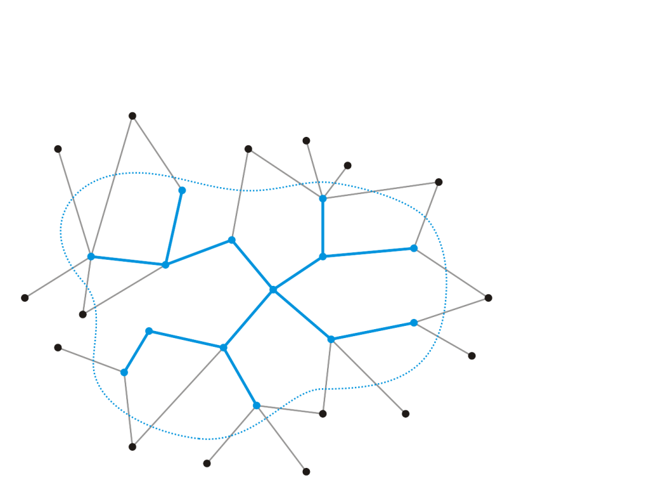
Strategy
Strategy:
Suppose we have a known minimum spanning tree on k < n vertices
How could we extend this minimum spanning tree?

Slide 26

Strategy
Add the edge e_{k} with least weight that connects this minimum spanning tree to a new vertex v_{k + 1}
This does create a minimum spanning tree on the k + 1 nodes—there is no other edge that extends the tree with less weight
Does the new edge belong to the minimum spanning tree on all n vertices?
Yes! The cut property.
v_{k + 1}
e_{k}

Slide 27
Cut property
Let S be any subset of nodes, and let e be the least weight edge with exactly one endpoint in S. Then the MST T* contains e.
Proof
Suppose e does not belong to T*.
Adding e to T* creates a cycle C in T*.
e is in a cycle C with exactly one endpoint in S ⇒ there exists another edge f in C with exactly one endpoint in S.
T' = T* ∪ {e} − {f} is also a spanning tree.
Since w_{e} < w_{f}, the weight of T' is smaller than that of T*.
This is a contradiction
f
S
e
T*
Notes:
Adapted from a slide by Kevin Wayne. Copyright © 2005 Pearson-Addison Wesley.

Slide 28
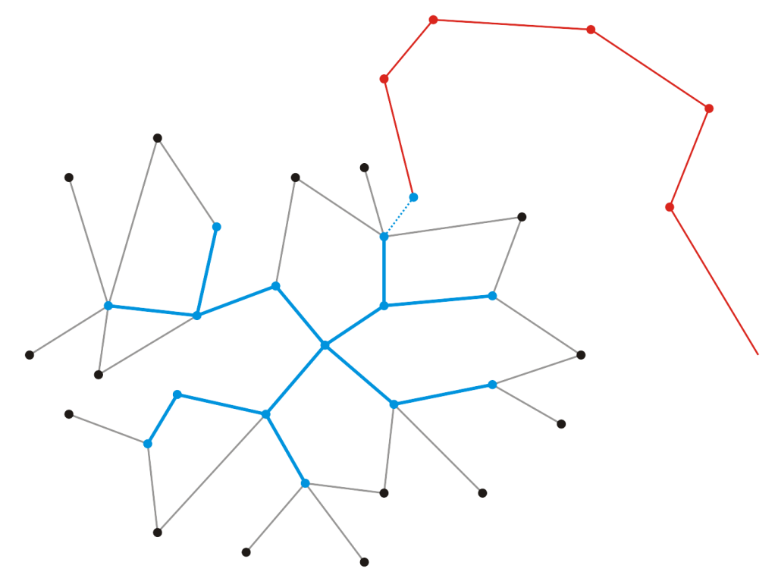
Proof
Suppose it does not
Thus, vertex v_{k + 1} is connected to the minimum spanning tree via another sequence of edges
v_{k + 1}
e_{k}

Slide 29
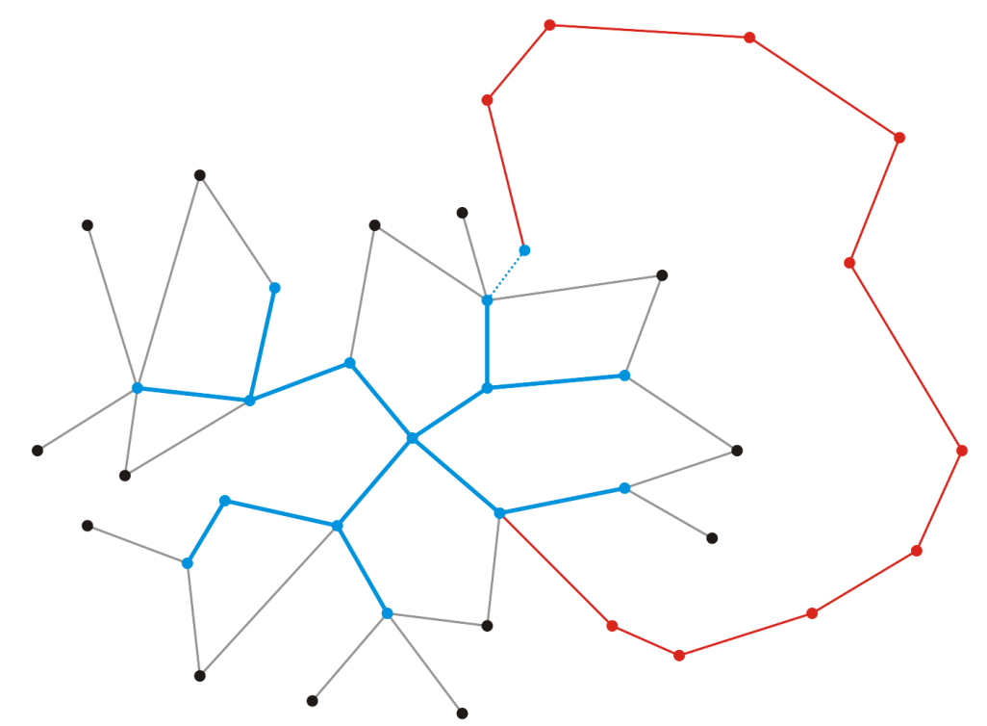
Proof
Because a minimum spanning tree is connected, there must be a path from vertex v_{k + 1} back to our existing minimum spanning tree
Let the last edge in this path be
v_{k + 1}
e_{k}

Slide 30
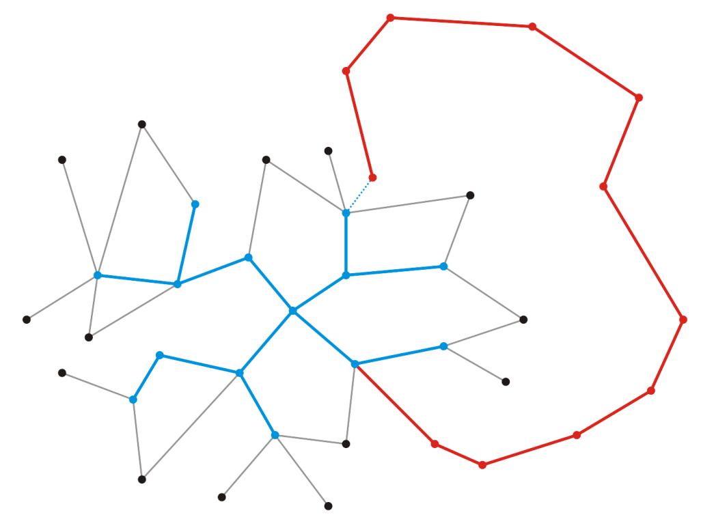
Proof
Let w be the weight of this minimum spanning tree
Recall, however, that when we chose to add v_{k + 1}, it was because e_{k} was the edge connecting an adjacent vertex with least weight
Therefore where |e| represents the weight of the edge e
v_{k + 1}
e_{k}

Slide 31
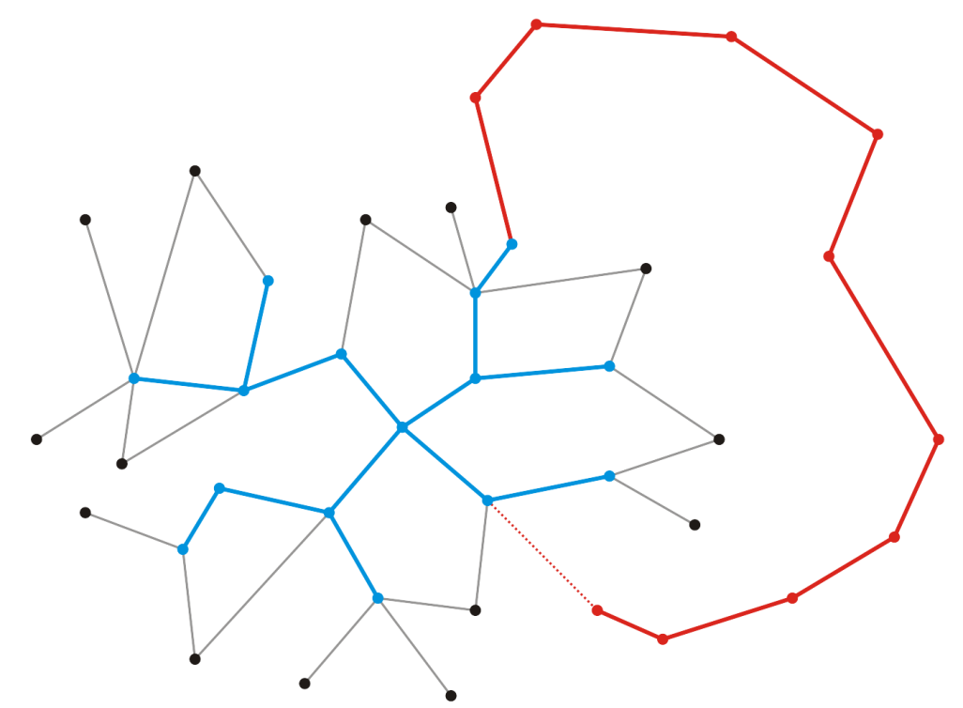
Proof
Suppose we swap edges and choose to include e_{k} and exclude
The result is still a spanning tree, but the weight is now
v_{k + 1}
e_{k + 1}

Slide 32
Proof
Thus, by swapping e_{k} for , we have a spanning tree that has less weight than the so-called minimum spanning tree containing
This contradicts our assumption that the spanning tree containing was minimal
Therefore, we have proved that our minimum spanning tree must contain e_{k}
v_{k + 1}
e_{k}

Slide 33
Strategy
Recall that we did not prescribe the value of k, and thus, k could be any value, including k = 1
v_{k + 1}
e_{k}

Slide 34
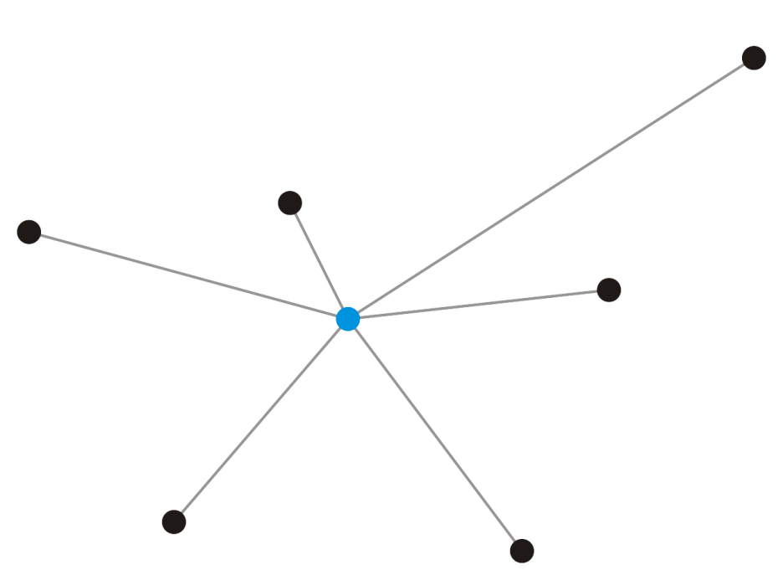
Strategy
Recall that we did not prescribe the value of k, and thus, k could be any value, including k = 1
Given a single vertex e₁, it forms a minimum spanning tree on one vertex
v₁

Slide 35
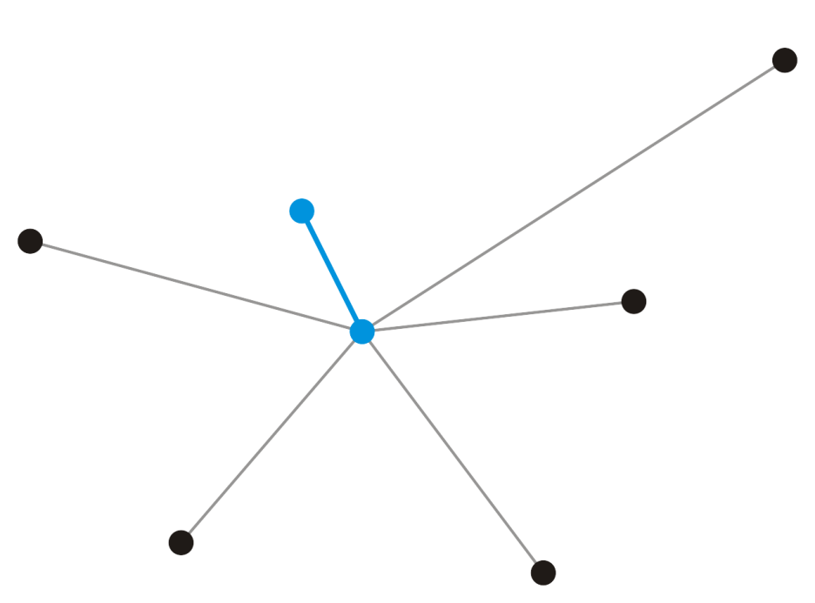
Strategy
Add that adjacent vertex v₂ that has a connecting edge e₁ of minimum weight
This forms a minimum spanning tree on our two vertices and e₁ must be in any minimum spanning tree containing the vertices v₁ and v₂
v₂
e₁
v₁

Slide 36
Prim’s Algorithm
Prim’s algorithm for finding the minimum spanning tree states:
Start with an arbitrary vertex to form a minimum spanning tree on one vertex
At each step, add the edge with least weight that connects the current minimum spanning tree to a new vertex
Continue until we have n – 1 edges and n vertices

Slide 37
Prim’s Algorithm
Associate with each vertex three items of data:
A Boolean flag indicating if the vertex has been visited,
The minimum distance (weight of a connecting edge) to the partially constructed tree, and
A pointer to a vertex which will form the parent node in the resulting tree
Implementation:
Add three member variables to the vertex class
Or track three tables
Notes:
Go back to the example in slide 30 to explain

Slide 38
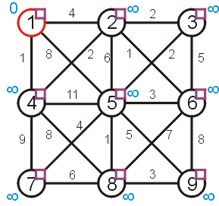
Prim’s Algorithm
Visited or not
 |  | Distance | Parent
1
2
3
4
5
6
7
8
9

Slide 39
Prim’s Algorithm
Initialization:
Select a root node and set its distance as 0
Set the distance to all other vertices as ∞
Set all vertices to being unvisited
Set the parent pointer of all vertices to 0

Slide 40
Prim’s Algorithm
Halting Conditions:
There are no unvisited vertices which have a distance < ∞
If all vertices have been visited, we have a spanning tree of the entire graph
If there are vertices with distance ∞, then the graph is not connected and we only have a minimum spanning tree of the connected sub-graph containing the root

Slide 41
Prim’s Algorithm
First we initialize the table
 |  | Distance | Parent
1 | F | 0 | 0
2 | F | ∞ | 0
3 | F | ∞ | 0
4 | F | ∞ | 0
5 | F | ∞ | 0
6 | F | ∞ | 0
7 | F | ∞ | 0
8 | F | ∞ | 0
9 | F | ∞ | 0

Slide 42
Prim’s Algorithm
Iterate while there exists an unvisited vertex with distance < ∞
Select the unvisited vertex v with minimum distance
Mark v as having been visited
For each unvisited adjacent vertex of v, if the weight of the connecting edge is less than the current distance to that vertex:
Update the distance to the weight of the edge
Set v as the parent of the vertex

Slide 43
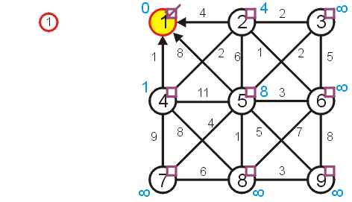
Prim’s Algorithm
Visiting vertex 1, we update vertices 2, 4, and 5
 |  | Distance | Parent
1 | T | 0 | 0
2 | F | 4 | 1
3 | F | ∞ | 0
4 | F | 1 | 1
5 | F | 8 | 1
6 | F | ∞ | 0
7 | F | ∞ | 0
8 | F | ∞ | 0
9 | F | ∞ | 0

Slide 44
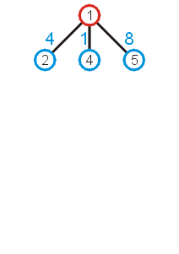
Prim’s Algorithm
What these numbers really mean is that at this point, we could extend the trivial tree containing just the root node by one of the three possible children:
As we wish to find a minimum spanning tree, it makes sense we add that vertex with a connecting edge with least weight

Slide 45
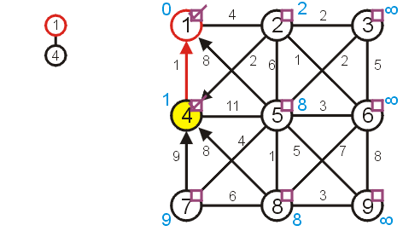
Prim’s Algorithm
The next unvisited vertex with minimum distance is vertex 4
Update vertices 2, 7, 8
Don’t update vertex 5
 |  | Distance | Parent
1 | T | 0 | 0
2 | F | 2 | 4
3 | F | ∞ | 0
4 | T | 1 | 1
5 | F | 8 | 1
6 | F | ∞ | 0
7 | F | 9 | 4
8 | F | 8 | 4
9 | F | ∞ | 0

Slide 46
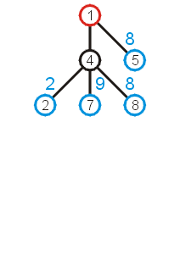
Prim’s Algorithm
Now that we have updated all vertices adjacent to vertex 4, we can extend the tree by adding one of the edges
(1, 5), (4, 2), (4, 7), or (4, 8)
We add that edge with the least weight: (4, 2)

Slide 47
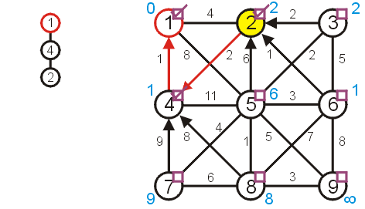
Prim’s Algorithm
Next visit vertex 2
Update 3, 5, and 6
 |  | Distance | Parent
1 | T | 0 | 0
2 | T | 2 | 4
3 | F | 2 | 2
4 | T | 1 | 1
5 | F | 6 | 2
6 | F | 1 | 2
7 | F | 9 | 4
8 | F | 8 | 4
9 | F | ∞ | 0

Slide 48
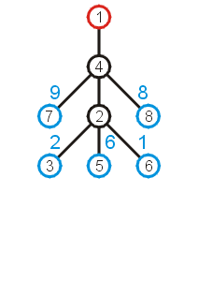
Prim’s Algorithm
Again looking at the shortest edges to each of the vertices adjacent to the current tree, we note that we can add (2, 6) with the least increase in weight

Slide 49
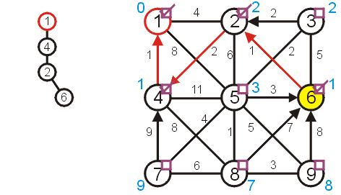
Prim’s Algorithm
Next, we visit vertex 6:
update vertices 5, 8, and 9
 |  | Distance | Parent
1 | T | 0 | 0
2 | T | 2 | 4
3 | F | 2 | 2
4 | T | 1 | 1
5 | F | 3 | 6
6 | T | 1 | 2
7 | F | 9 | 4
8 | F | 7 | 6
9 | F | 8 | 6

Slide 50
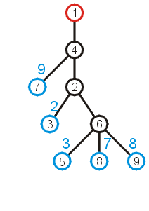
Prim’s Algorithm
The edge with least weight is (2, 3)
This adds the weight of 2 to the weight minimum spanning tree

Slide 51
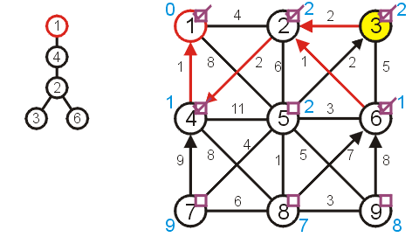
Prim’s Algorithm
Next, we visit vertex 3 and update 5
 |  | Distance | Parent
1 | T | 0 | 0
2 | T | 2 | 4
3 | T | 2 | 2
4 | T | 1 | 1
5 | F | 2 | 3
6 | T | 1 | 2
7 | F | 9 | 4
8 | F | 7 | 6
9 | F | 8 | 6

Slide 52
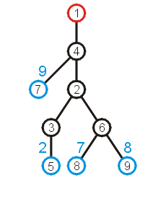
Prim’s Algorithm
At this point, we can extend the tree by adding the edge (3, 5)

Slide 53
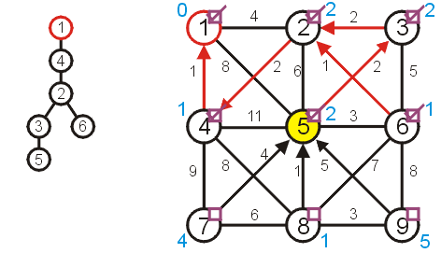
Prim’s Algorithm
Visiting vertex 5, we update 7, 8, 9
 |  | Distance | Parent
1 | T | 0 | 0
2 | T | 2 | 4
3 | T | 2 | 2
4 | T | 1 | 1
5 | T | 2 | 3
6 | T | 1 | 2
7 | F | 4 | 5
8 | F | 1 | 5
9 | F | 5 | 5

Slide 54
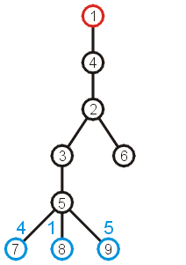
Prim’s Algorithm
At this point, there are three possible edges which we could include which will extend the tree
The edge to 8 has the least weight

Slide 55
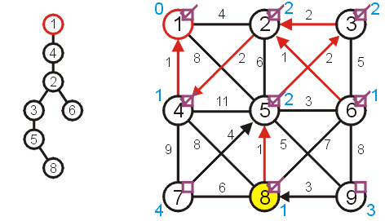
Prim’s Algorithm
Visiting vertex 8, we only update vertex 9
 |  | Distance | Parent
1 | T | 0 | 0
2 | T | 2 | 4
3 | T | 2 | 2
4 | T | 1 | 1
5 | T | 2 | 3
6 | T | 1 | 2
7 | F | 4 | 5
8 | T | 1 | 5
9 | F | 3 | 8

Slide 56
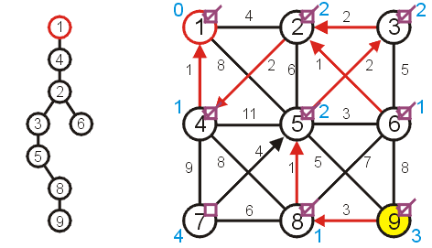
Prim’s Algorithm
There are no other vertices to update while visiting vertex 9
 |  | Distance | Parent
1 | T | 0 | 0
2 | T | 2 | 4
3 | T | 2 | 2
4 | T | 1 | 1
5 | T | 2 | 3
6 | T | 1 | 2
7 | F | 4 | 5
8 | T | 1 | 5
9 | T | 3 | 8

Slide 57
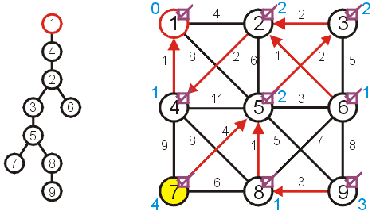
Prim’s Algorithm
And neither are there any vertices to update when visiting vertex 7
 |  | Distance | Parent
1 | T | 0 | 0
2 | T | 2 | 4
3 | T | 2 | 2
4 | T | 1 | 1
5 | T | 2 | 3
6 | T | 1 | 2
7 | T | 4 | 5
8 | T | 1 | 5
9 | T | 3 | 8

Slide 58
Prim’s Algorithm
At this point, there are no more unvisited vertices, and therefore we are done
If at any point, all remaining vertices had a distance of ∞, this would indicate that the graph is not connected
in this case, the minimum spanning tree would only span one connected sub-graph

Slide 59
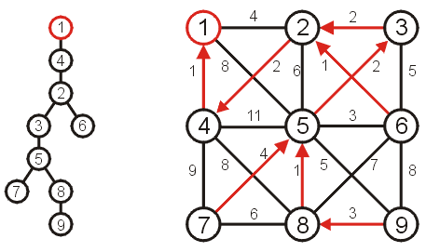
Prim’s Algorithm
Using the parent pointers, we can now construct the minimum spanning tree
 |  | Distance | Parent
1 | T | 0 | 0
2 | T | 2 | 4
3 | T | 2 | 2
4 | T | 1 | 1
5 | T | 2 | 3
6 | T | 1 | 2
7 | T | 4 | 5
8 | T | 1 | 5
9 | T | 3 | 8

Slide 60
Prim’s Algorithm
To summarize:
we begin with a vertex which represents the root
starting with this trivial tree and iteration, we find the shortest edge which we can add to this already existing tree to expand it

Slide 61
Implementation and analysis
The initialization requires Θ(|V|) memory and run time
We iterate |V| – 1 times, each time finding the closest vertex
Iterating through the table requires is Θ(|V|) time
Each time we find a vertex, we must check all of its neighbors
With an adjacency list, the run time is Θ(|V|² + |E|) = Θ(|V|²) as |E| = O(|V|²)
Can we do better?
At each iteration, we need to find the shortest edge
How about a priority queue?
Assume we are using a binary heap
Notes:
With an adjacency matrix, the run time is Θ(|V|(|V| + |V|)) = Θ(|V|²)

Slide 62
Implementation and analysis
The initialization still requires Θ(|V|) memory and run time
The priority queue will also requires Ο(|V|) memory
We iterate |V| – 1 times, each time finding the closest vertex
The size of the priority queue is Ο(|V|)
Pop the closest vertex from the priority queue is O(ln(|V|))
For each of its neighbors, we may update the distance, which is O(ln(|V|)) (“decrease key” can be done with O(ln(|V|)) in a heap).
With an adjacency list, the total run time is O(|V| ln(|V|) + |E| ln(|V|)) = O(|E| ln(|V|))

Slide 63
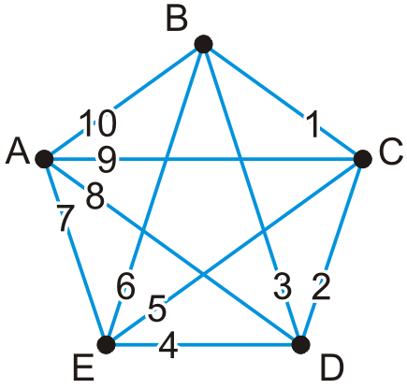
Implementation and analysis
Here is a worst-case graph if we were to start with Vertex A
Assume that the adjacency lists are in order
Each time, the edge is percolated to the top of the heap

Slide 64
Implementation and analysis
We could use a different heap structure:
A Fibonacci heap is a node-based heap
Pop is still O(ln(|V|)), but inserting and moving a key is Θ(1)
Thus, the overall run-time is O(|E| + |V| ln(|V|))

Slide 65
Implementation and analysis
Thus, we have two run times when using
A binary heap: O(|E| ln(|V|))
A Fibonacci heap: O(|E| + |V| ln(|V|))
Questions: Which is faster if |E| = Θ(|V|)? How about if |E| = Θ(|V|²)?

Slide 66
Summary
We have seen an algorithm for finding minimum spanning trees
Start with a trivial minimum spanning tree and grow it
An alternate algorithm, Kruskal’s algorithm, uses a different approach
Prim’s algorithm finds an edge with least weight which grows an already existing tree
It solves the problem in O(|E| ln(|V|)) time

Slide 67
Outline
Definition and applications
Prim’s algorithm
Kruskal’s algorithm

Slide 68
Outline
This topic covers Kruskal’s algorithm:
Finding a minimum spanning tree
The idea and the algorithm
An example
Using a disjoint set data structure

Slide 69
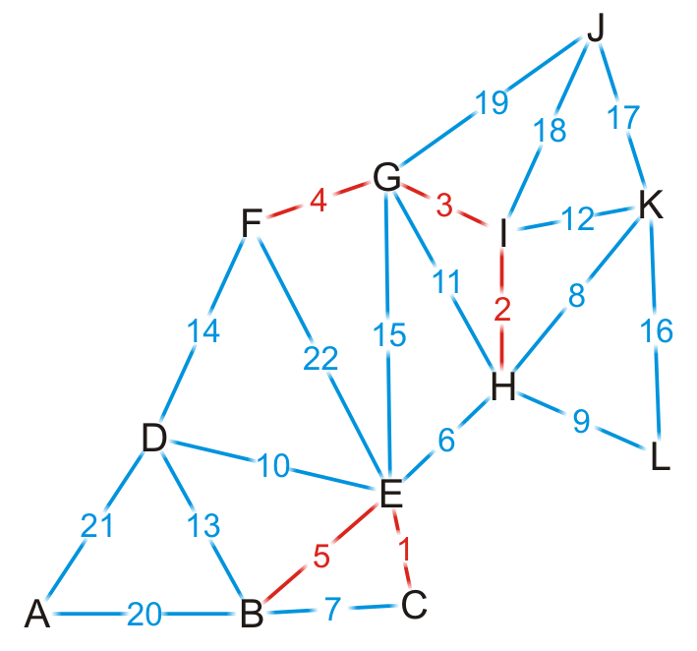
Kruskal’s Algorithm
Sort the edges by weight
Go through the edges from least weight to greatest weight
add the edges to the spanning tree so long as the addition does not create a cycle
Does this edge belong to the minimum spanning tree?
Yes! The cut property (consider the subtree connected to one end of the edge as the set S).

Slide 70
Kruskal’s Algorithm
Sort the edges by weight
Go through the edges from least weight to greatest weight
add the edges to the spanning tree so long as the addition does not create a cycle
Does this edge belong to the minimum spanning tree?
Yes! The cut property (consider the subtree connected to one end of the edge as the set S).
Repeatedly add more edges until:
|V| – 1 edges have been added, then we have a minimum spanning tree
Otherwise, if we have gone through all the edges, then we have a forest of minimum spanning trees on all connected sub-graphs

Slide 71
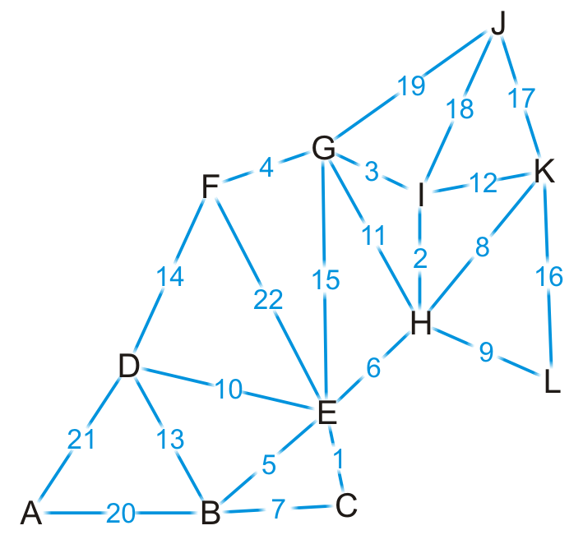
Example
Here is an example graph

Slide 72
Example
{C, E}
{H, I}
{G, I}
{F, G}
{B, E}
{E, H}
{B, C}
{H, K}
{H, L}
{D, E}
{G, H}
{I, K}
{B, D}
{D, F}
{E, G}
{K, L}
{J, K}
{J, I}
{J, G}
{A, B}
{A, D}
{E, F}
First, we sort the edges based on weight

Slide 73

Example
{C, E}
{H, I}
{G, I}
{F, G}
{B, E}
{E, H}
{B, C}
{H, K}
{H, L}
{D, E}
{G, H}
{I, K}
{B, D}
{D, F}
{E, G}
{K, L}
{J, K}
{J, I}
{J, G}
{A, B}
{A, D}
{E, F}
We start by adding edge {C, E}

Slide 74
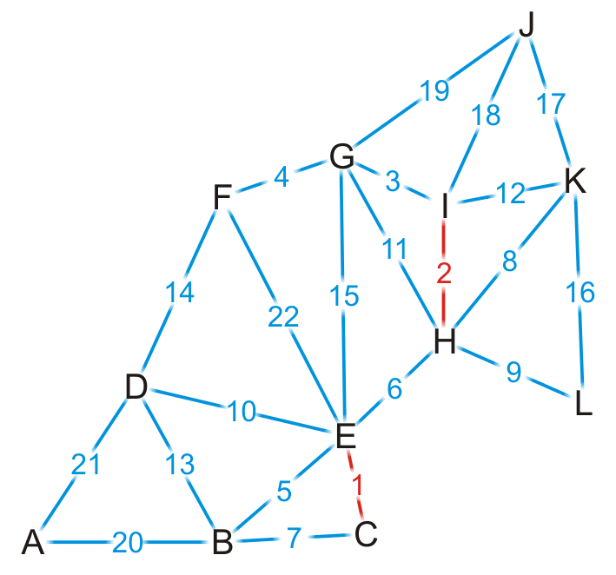
Example
{C, E}
{H, I}
{G, I}
{F, G}
{B, E}
{E, H}
{B, C}
{H, K}
{H, L}
{D, E}
{G, H}
{I, K}
{B, D}
{D, F}
{E, G}
{K, L}
{J, K}
{J, I}
{J, G}
{A, B}
{A, D}
{E, F}
We add edge {H, I}

Slide 75
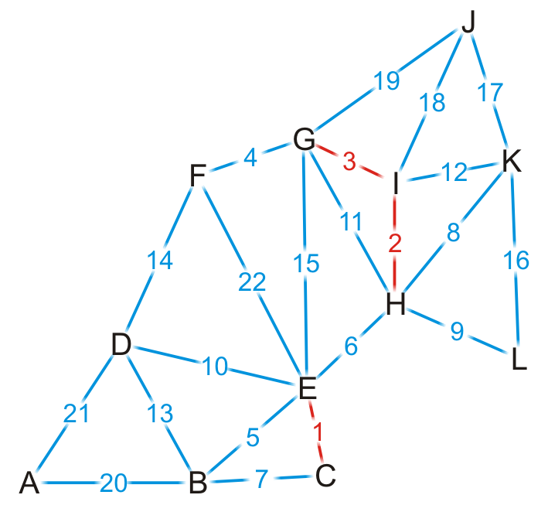
Example
{C, E}
{H, I}
{G, I}
{F, G}
{B, E}
{E, H}
{B, C}
{H, K}
{H, L}
{D, E}
{G, H}
{I, K}
{B, D}
{D, F}
{E, G}
{K, L}
{J, K}
{J, I}
{J, G}
{A, B}
{A, D}
{E, F}
We add edge {G, I}

Slide 76

Example
{C, E}
{H, I}
{G, I}
{F, G}
{B, E}
{E, H}
{B, C}
{H, K}
{H, L}
{D, E}
{G, H}
{I, K}
{B, D}
{D, F}
{E, G}
{K, L}
{J, K}
{J, I}
{J, G}
{A, B}
{A, D}
{E, F}
We add edge {F, G}

Slide 77
Example
{C, E}
{H, I}
{G, I}
{F, G}
{B, E}
{E, H}
{B, C}
{H, K}
{H, L}
{D, E}
{G, H}
{I, K}
{B, D}
{D, F}
{E, G}
{K, L}
{J, K}
{J, I}
{J, G}
{A, B}
{A, D}
{E, F}
We add edge {B, E}

Slide 78
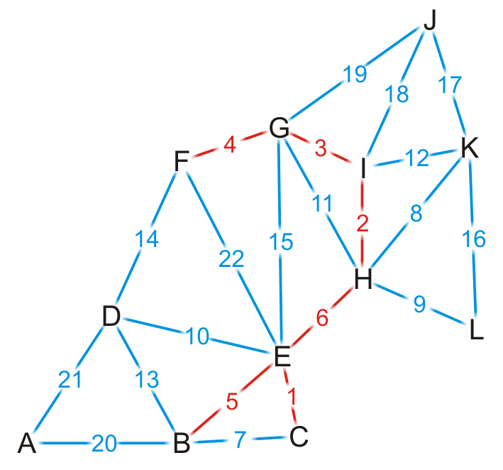
Example
{C, E}
{H, I}
{G, I}
{F, G}
{B, E}
{E, H}
{B, C}
{H, K}
{H, L}
{D, E}
{G, H}
{I, K}
{B, D}
{D, F}
{E, G}
{K, L}
{J, K}
{J, I}
{J, G}
{A, B}
{A, D}
{E, F}
We add edge {E, H}
This coalesces the two spanning sub-trees into one

Slide 79
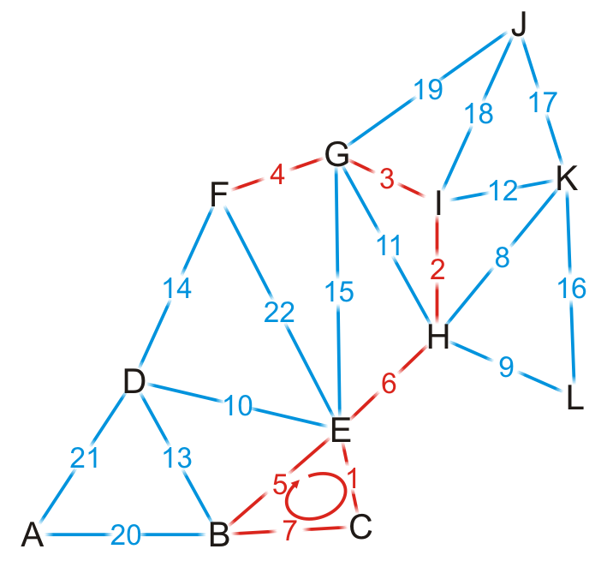
Example
{C, E}
{H, I}
{G, I}
{F, G}
{B, E}
{E, H}
{B, C}
{H, K}
{H, L}
{D, E}
{G, H}
{I, K}
{B, D}
{D, F}
{E, G}
{K, L}
{J, K}
{J, I}
{J, G}
{A, B}
{A, D}
{E, F}
We try adding {B, C}, but it creates a cycle

Slide 80
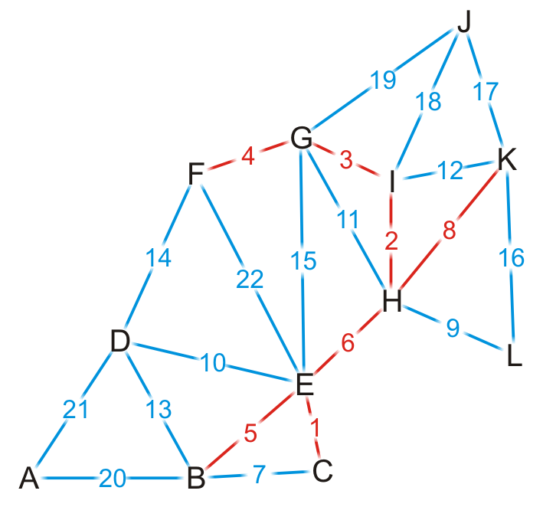
Example
{C, E}
{H, I}
{G, I}
{F, G}
{B, E}
{E, H}
{B, C}
{H, K}
{H, L}
{D, E}
{G, H}
{I, K}
{B, D}
{D, F}
{E, G}
{K, L}
{J, K}
{J, I}
{J, G}
{A, B}
{A, D}
{E, F}
We add edge {H, K}

Slide 81
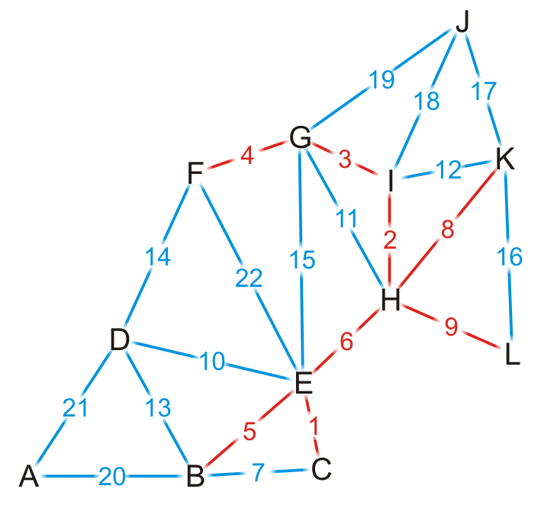
Example
{C, E}
{H, I}
{G, I}
{F, G}
{B, E}
{E, H}
{B, C}
{H, K}
{H, L}
{D, E}
{G, H}
{I, K}
{B, D}
{D, F}
{E, G}
{K, L}
{J, K}
{J, I}
{J, G}
{A, B}
{A, D}
{E, F}
We add edge {H, L}

Slide 82
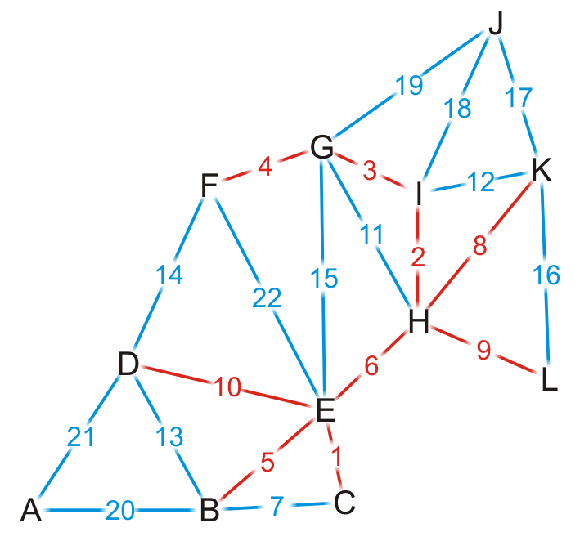
Example
{C, E}
{H, I}
{G, I}
{F, G}
{B, E}
{E, H}
{B, C}
{H, K}
{H, L}
{D, E}
{G, H}
{I, K}
{B, D}
{D, F}
{E, G}
{K, L}
{J, K}
{J, I}
{J, G}
{A, B}
{A, D}
{E, F}
We add edge {D, E}

Slide 83
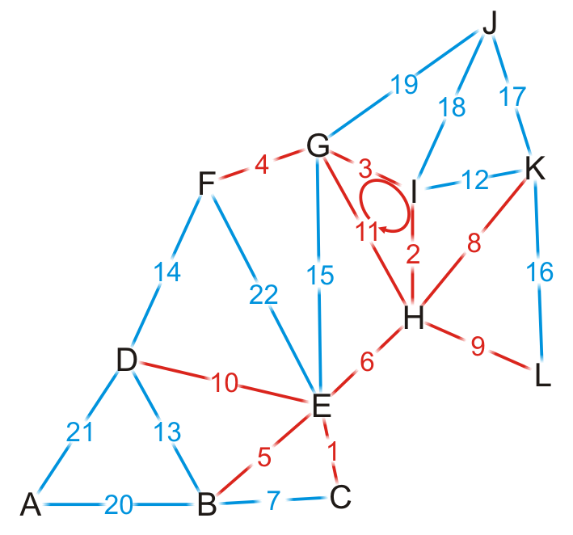
Example
{C, E}
{H, I}
{G, I}
{F, G}
{B, E}
{E, H}
{B, C}
{H, K}
{H, L}
{D, E}
{G, H}
{I, K}
{B, D}
{D, F}
{E, G}
{K, L}
{J, K}
{J, I}
{J, G}
{A, B}
{A, D}
{E, F}
We try adding {G, H}, but it creates a cycle

Slide 84
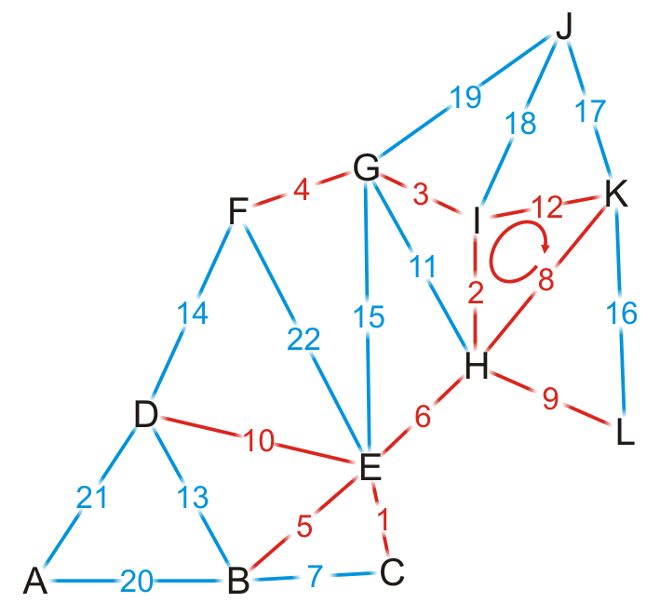
Example
{C, E}
{H, I}
{G, I}
{F, G}
{B, E}
{E, H}
{B, C}
{H, K}
{H, L}
{D, E}
{G, H}
{I, K}
{B, D}
{D, F}
{E, G}
{K, L}
{J, K}
{J, I}
{J, G}
{A, B}
{A, D}
{E, F}
We try adding {I, K}, but it creates a cycle

Slide 85

Example
{C, E}
{H, I}
{G, I}
{F, G}
{B, E}
{E, H}
{B, C}
{H, K}
{H, L}
{D, E}
{G, H}
{I, K}
{B, D}
{D, F}
{E, G}
{K, L}
{J, K}
{J, I}
{J, G}
{A, B}
{A, D}
{E, F}
We try adding {B, D}, but it creates a cycle

Slide 86

Example
{C, E}
{H, I}
{G, I}
{F, G}
{B, E}
{E, H}
{B, C}
{H, K}
{H, L}
{D, E}
{G, H}
{I, K}
{B, D}
{D, F}
{E, G}
{K, L}
{J, K}
{J, I}
{J, G}
{A, B}
{A, D}
{E, F}
We try adding {D, F}, but it creates a cycle

Slide 87

Example
{C, E}
{H, I}
{G, I}
{F, G}
{B, E}
{E, H}
{B, C}
{H, K}
{H, L}
{D, E}
{G, H}
{I, K}
{B, D}
{D, F}
{E, G}
{K, L}
{J, K}
{J, I}
{J, G}
{A, B}
{A, D}
{E, F}
We try adding {E, G}, but it creates a cycle

Slide 88

Example
{C, E}
{H, I}
{G, I}
{F, G}
{B, E}
{E, H}
{B, C}
{H, K}
{H, L}
{D, E}
{G, H}
{I, K}
{B, D}
{D, F}
{E, G}
{K, L}
{J, K}
{J, I}
{J, G}
{A, B}
{A, D}
{E, F}
By observation, we can still add edges {J, K} and {A, B}

Slide 89
Example
{C, E}
{H, I}
{G, I}
{F, G}
{B, E}
{E, H}
{B, C}
{H, K}
{H, L}
{D, E}
{G, H}
{I, K}
{B, D}
{D, F}
{E, G}
{K, L}
{J, K}
{J, I}
{J, G}
{A, B}
{A, D}
{E, F}
Having added {A, B}, we now have 11 edges
We terminate the loop
We have our minimum spanning tree

Slide 90
Analysis
Implementation
We would store the edges and their weights in an array
We would sort the edges using some sorting algorithm: Ο(|E| ln(|E|))
For each edge, add it if no cycle is created.
How do we determine if a cycle would be created?
Check if the two vertices of the edge are already connected by the added edges.
The critical operation is determining if two vertices are connected
If we perform a traversal on the added edges, it is Ο(|V|). Consequently, the total run-time would be Ο(|E| ln(|E|) + |E|·|V|) = Ο(|E|·|V|)
Better solution?
Notes:
However, |E| = O(|V|²), so ln(E) = O(ln(|V|²)) = O(2 ln(|V|)) = O(ln(|V|))
Consequently, the run-time would be Ο(|E| ln(|V|) + |E||V|) = Ο(|E|·|V|)

Slide 91
Analysis
Instead, we could use disjoint sets
Consider edges in the same connected sub-graph as forming a set
{B, C, E}, {F, G, H, I}

Slide 92
Analysis
Instead, we could use disjoint sets
Consider edges in the same connected sub-graph as forming a set
If the vertices of the next edge are in different sets, take the union of the two sets
Add edge (E, H)?
{B, C, E}, {F, G, H, I}
{B, C, E, F, G, H, I}

Slide 93
Analysis
Instead, we could use disjoint sets
Consider edges in the same connected sub-graph as forming a set
If the vertices of the next edge are in different sets, take the union of the two sets
Do not add an edge if both vertices are in the same set
Add edge (B, C)?
{B, C, E}, {F, G, H, I}

Slide 94
Analysis
The disjoint set data structure has run-time O(α(n)), which is effectively a near-constant
Thus, checking and building the minimum spanning tree is now Ο(|E|)
The dominant time is now the time required to sort the edges, which is Ο(|E| ln(|E|)) = Ο(|E| ln(|V|))
If there is an efficient Θ(|E|) sorting algorithm, the run-time is then Θ(|E|)
Notes:
为什么可以写成 O(∣E∣ln⁡(∣V∣))\mathcal{O}(|E| \ln(|V|))O(∣E∣ln(∣V∣))？
这是基于稀疏图与稠密图的关系：
边数和顶点数的关系：
在最稠密图中，边数最多为 ∣E∣=O(∣V∣2)|E| = \mathcal{O}(|V|^2)∣E∣=O(∣V∣2)。
在稀疏图中，∣E∣|E|∣E∣ 最小为 ∣V∣−1|V| - 1∣V∣−1（如树结构）。
对 ∣E∣ln⁡(∣E∣)|E| \ln(|E|)∣E∣ln(∣E∣) 的转换：
∣E∣≤∣V∣2|E| \leq |V|^2∣E∣≤∣V∣2，所以 ln⁡(∣E∣)≤ln⁡(∣V∣2)=2ln⁡(∣V∣)\ln(|E|) \leq \ln(|V|^2) = 2\ln(|V|)ln(∣E∣)≤ln(∣V∣2)=2ln(∣V∣)。
这意味着 O(∣E∣ln⁡(∣E∣))\mathcal{O}(|E| \ln(|E|))O(∣E∣ln(∣E∣)) 的上界可以写作 O(∣E∣ln⁡(∣V∣))\mathcal{O}(|E| \ln(|V|))O(∣E∣ln(∣V∣))。
这种表示方式尤其适用于稀疏图（如 ∣E∣=O(∣V∣)|E| = \mathcal{O}(|V|)∣E∣=O(∣V∣)），因为此时 ln⁡(∣V∣)\ln(|V|)ln(∣V∣) 的增长较慢。

Slide 95
Example
Going through the example again with disjoint sets

Slide 96
Example
{C, E}
{H, I}
{G, I}
{F, G}
{B, E}
{E, H}
{B, C}
{H, K}
{H, L}
{D, E}
{G, H}
{I, K}
{B, D}
{D, F}
{E, G}
{K, L}
{J, K}
{J, I}
{J, G}
{A, B}
{A, D}
{E, F}
We start with twelve singletons
{A}, {B}, {C}, {D}, {E}, {F}, {G}, {H}, {I}, {J}, {K}, {L}

Slide 97
Example
{C, E}
{H, I}
{G, I}
{F, G}
{B, E}
{E, H}
{B, C}
{H, K}
{H, L}
{D, E}
{G, H}
{I, K}
{B, D}
{D, F}
{E, G}
{K, L}
{J, K}
{J, I}
{J, G}
{A, B}
{A, D}
{E, F}
We start by adding edge {C, E}
{A}, {B}, {C, E}, {D}, {F}, {G}, {H}, {I}, {J}, {K}, {L}

Slide 98
Example
{C, E}
{H, I}
{G, I}
{F, G}
{B, E}
{E, H}
{B, C}
{H, K}
{H, L}
{D, E}
{G, H}
{I, K}
{B, D}
{D, F}
{E, G}
{K, L}
{J, K}
{J, I}
{J, G}
{A, B}
{A, D}
{E, F}
We add edge {H, I}
{A}, {B}, {C, E}, {D}, {F}, {G}, {H, I}, {J}, {K}, {L}

Slide 99
Example
{C, E}
{H, I}
{G, I}
{F, G}
{B, E}
{E, H}
{B, C}
{H, K}
{H, L}
{D, E}
{G, H}
{I, K}
{B, D}
{D, F}
{E, G}
{K, L}
{J, K}
{J, I}
{J, G}
{A, B}
{A, D}
{E, F}
Similarly, we add {G, I}, {F, G}, {B, E}
{A}, {B, C, E}, {D}, {F, G, H, I}, {J}, {K}, {L}

Slide 100
Example
{C, E}
{H, I}
{G, I}
{F, G}
{B, E}
{E, H}
{B, C}
{H, K}
{H, L}
{D, E}
{G, H}
{I, K}
{B, D}
{D, F}
{E, G}
{K, L}
{J, K}
{J, I}
{J, G}
{A, B}
{A, D}
{E, F}
The vertices of {E, H} are in different sets
{A}, {B, C, E}, {D}, {F, G, H, I}, {J}, {K}, {L}

Slide 101
Example
{C, E}
{H, I}
{G, I}
{F, G}
{B, E}
{E, H}
{B, C}
{H, K}
{H, L}
{D, E}
{G, H}
{I, K}
{B, D}
{D, F}
{E, G}
{K, L}
{J, K}
{J, I}
{J, G}
{A, B}
{A, D}
{E, F}
Adding edge {E, H} creates a larger union
{A}, {B, C, E, F, G, H, I}, {D}, {J}, {K}, {L}

Slide 102
Example
{C, E}
{H, I}
{G, I}
{F, G}
{B, E}
{E, H}
{B, C}
{H, K}
{H, L}
{D, E}
{G, H}
{I, K}
{B, D}
{D, F}
{E, G}
{K, L}
{J, K}
{J, I}
{J, G}
{A, B}
{A, D}
{E, F}
We try adding {B, C}, but it creates a cycle
{A}, {B, C, E, F, G, H, I}, {D}, {J}, {K}, {L}

Slide 103
Example
{C, E}
{H, I}
{G, I}
{F, G}
{B, E}
{E, H}
{B, C}
{H, K}
{H, L}
{D, E}
{G, H}
{I, K}
{B, D}
{D, F}
{E, G}
{K, L}
{J, K}
{J, I}
{J, G}
{A, B}
{A, D}
{E, F}
We add edge {H, K}, {H, L} and {D, E}
{A}, {B, C, D, E, F, G, H, I, K, L}, {J}

Slide 104
Example
{C, E}
{H, I}
{G, I}
{F, G}
{B, E}
{E, H}
{B, C}
{H, K}
{H, L}
{D, E}
{G, H}
{I, K}
{B, D}
{D, F}
{E, G}
{K, L}
{J, K}
{J, I}
{J, G}
{A, B}
{A, D}
{E, F}
Both G and H are in the same set
{A}, {B, C, D, E, F, G, H, I, K, L}, {J}

Slide 105
Example
{C, E}
{H, I}
{G, I}
{F, G}
{B, E}
{E, H}
{B, C}
{H, K}
{H, L}
{D, E}
{G, H}
{I, K}
{B, D}
{D, F}
{E, G}
{K, L}
{J, K}
{J, I}
{J, G}
{A, B}
{A, D}
{E, F}
Both {I, K} are in the same set
{A}, {B, C, D, E, F, G, H, I, K, L}, {J}

Slide 106
Example
{C, E}
{H, I}
{G, I}
{F, G}
{B, E}
{E, H}
{B, C}
{H, K}
{H, L}
{D, E}
{G, H}
{I, K}
{B, D}
{D, F}
{E, G}
{K, L}
{J, K}
{J, I}
{J, G}
{A, B}
{A, D}
{E, F}
Both {B, D} are in the same set
{A}, {B, C, D, E, F, G, H, I, K, L}, {J}

Slide 107
Example
{C, E}
{H, I}
{G, I}
{F, G}
{B, E}
{E, H}
{B, C}
{H, K}
{H, L}
{D, E}
{G, H}
{I, K}
{B, D}
{D, F}
{E, G}
{K, L}
{J, K}
{J, I}
{J, G}
{A, B}
{A, D}
{E, F}
Both {D, F} are in the same set
{A}, {B, C, D, E, F, G, H, I, K, L}, {J}

Slide 108
Example
{C, E}
{H, I}
{G, I}
{F, G}
{B, E}
{E, H}
{B, C}
{H, K}
{H, L}
{D, E}
{G, H}
{I, K}
{B, D}
{D, F}
{E, G}
{K, L}
{J, K}
{J, I}
{J, G}
{A, B}
{A, D}
{E, F}
We end when there is only one set, having added (A, B)
{A, B, C, D, E, F, G, H, I, K, L, J}

Slide 109
Summary
This topic has covered Kruskal’s algorithm
Sort the edges by weight
Create a disjoint set of the vertices
Begin adding the edges one-by-one checking to ensure no cycles are introduced
The result is a minimum spanning tree
The run time is Ο(|E| ln(|V|)
Notes:
为什么可以写成 O(∣E∣ln⁡(∣V∣))\mathcal{O}(|E| \ln(|V|))O(∣E∣ln(∣V∣))？
这是基于稀疏图与稠密图的关系：
边数和顶点数的关系：
在最稠密图中，边数最多为 ∣E∣=O(∣V∣2)|E| = \mathcal{O}(|V|^2)∣E∣=O(∣V∣2)。
在稀疏图中，∣E∣|E|∣E∣ 最小为 ∣V∣−1|V| - 1∣V∣−1（如树结构）。
对 ∣E∣ln⁡(∣E∣)|E| \ln(|E|)∣E∣ln(∣E∣) 的转换：
∣E∣≤∣V∣2|E| \leq |V|^2∣E∣≤∣V∣2，所以 ln⁡(∣E∣)≤ln⁡(∣V∣2)=2ln⁡(∣V∣)\ln(|E|) \leq \ln(|V|^2) = 2\ln(|V|)ln(∣E∣)≤ln(∣V∣2)=2ln(∣V∣)。
这意味着 O(∣E∣ln⁡(∣E∣))\mathcal{O}(|E| \ln(|E|))O(∣E∣ln(∣E∣)) 的上界可以写作 O(∣E∣ln⁡(∣V∣))\mathcal{O}(|E| \ln(|V|))O(∣E∣ln(∣V∣))。
这种表示方式尤其适用于稀疏图（如 ∣E∣=O(∣V∣)|E| = \mathcal{O}(|V|)∣E∣=O(∣V∣)），因为此时 ln⁡(∣V∣)\ln(|V|)ln(∣V∣) 的增长较慢。

Slide 110
References
Wikipedia, http://en.wikipedia.org/wiki/Minimum_spanning_tree
Wikipedia, http://en.wikipedia.org/wiki/Kruskal’s_algorithm
These slides are provided for the ECE 250 Algorithms and Data Structures course. The material in it reflects Douglas W. Harder’s best judgment in light of the information available to him at the time of preparation. Any reliance on these course slides by any party for any other purpose are the responsibility of such parties. Douglas W. Harder accepts no responsibility for damages, if any, suffered by any party as a result of decisions made or actions based on these course slides for any other purpose than that for which it was intended.

Slide 111
Summary
Definition and applications
Prim’s algorithm
Start with a trivial minimum spanning tree and grow it by adding edges with least weight
Kruskal’s algorithm
Go through the edges from least weight to greatest weight, adding an edge if it does not create a cycle

